Slide 1
Robot Teams
Topics:
Teamwork and Its Challenges
Coordination, Communication and Control

Slide 2
Why Teams?
It takes two (or more)
Such as cooperative transportation: Pushing a box, fragile objects
Better, faster, cheaper
Such as Foraging , more robots can cover a larger area, but too many could get in each other’s way
Being everywhere at once
Sensor-actuator networks (for intruder, emergency monitoring), habitat monitoring
Drones
Having “nine lives”
Increased robustness because of redundancy (robots share the same structure and capabilities)

Slide 3
Challenges of Teamwork
Coordination
Interference among robots, goal conflicting (one robot could undo the work of another)
Communication
Wireless radio is the preferred way of communication, has to avoid collisions
Organization
More robots, more uncertainty
Cost involved
More robots, more cost (hardware or maintenance)

Slide 4
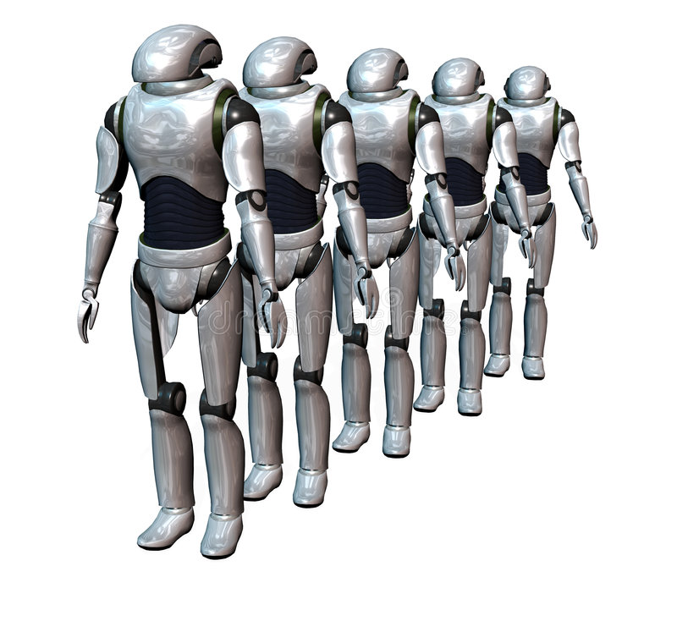
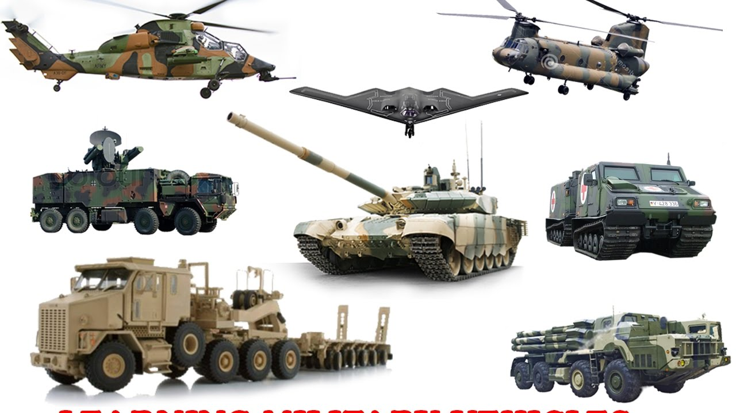
Types of Groups and Teams Division of labor or role assignment
Homogeneous Teams Identical (in form and/or function), interchangeable members | Heterogeneous Teams Different, non-interchangeable members Typically requires active cooperation in order to produce coordinated behavior

Slide 5
Coordination Strategy
Merely coexisting
no communication or even recognition of each other (seen as obstacles).
Interference increases with the # of members.
Well-suited for foraging, construction, etc
Loosely coupled
group recognition, simple coordination,
don’t depend on each other, robust,
Well-suited for foraging, herding, distributed mapping, etc
Tightly coupled
Cooperate on a precise task using communication, turn-taking.
Dependent on each other, with improved group performance
Less redundancy and less robustness
e.g. soccer playing, moving in formation, transporting objects, etc

Slide 6
Communication
Helps with
Improving perception
Synchronizing action
Enabling coordination and negotiation
For example using communication in foraging
Nothing (could still work well in merely coexisting)
Task-related state: locations of objects, # of recently seen robots, etc
Individual state: ID #, energy level, # of objects collected, etc
Environment state: blocked paths, dangerous conditions, new-found shortcuts, etc
Goal(s): direction to the nearest object, etc
Intentions: I’m going that way because ...

Slide 7
4 How to Communicate?
As humans, we
Use gestures, speech, send or leave messages, etc.
As robots, they use
Explicit communication
Broadcast, peer-to-peer, publish-subscribe
Has to consider performance issue, what if message is lost?
Implicit communication
Individual robot leaving information in the environment
Stigmergy – information is conveyed through changing the environment, such as ant trails (pheromone left by ants).

Slide 9
5 Kin Recognition
Being able to recognize “others like me” could be very beneficial
In group robotics, kin recognition refers to
Distinguishing another robot from other objects
Recognizing one’s team members
Robots can establish a dominance hierarchy to
help give structure and order to a group to avoid interference
Two types of hierarchies exist:
Fixed (static) hierarchy: determined once and does not change
Dynamic hierarchy: formed based on some quality (e.g. strength)

Slide 10
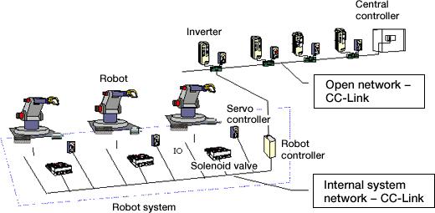
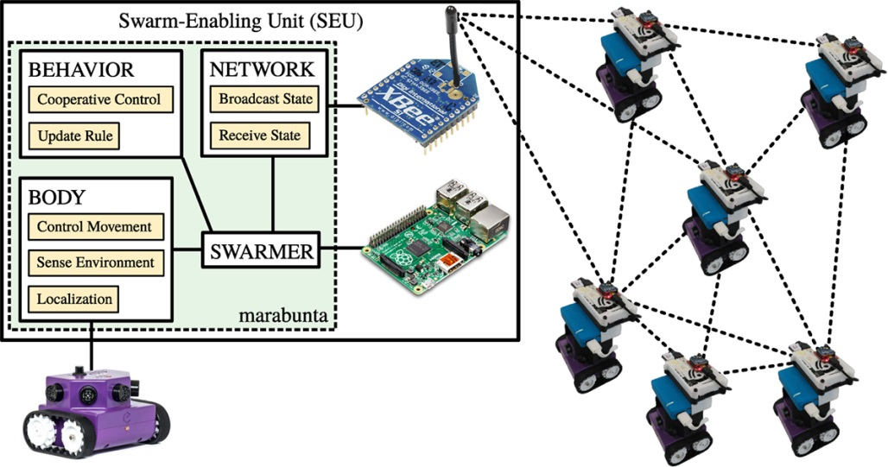
Control of a Group of Robots
I’m the Boss: Centralized Control Single, centralized controller takes information from all other robots, thinks, sends commands to all Is slow and gets slower when the team size increases Not robust and the centralized controller is a bottleneck of the whole system | Work It Out as a Team: Distributed Control Control is spread over multiple/all members of the team Each robot uses its own controller to decide what to do No central information gathering, no bottlenecks Works well with large teams, doesn’t slow down with size

Slide 11
Architectures for Multi-Robot Control
Deliberative control
well suited for centralized control
Reactive control
Well suited for implementing the distributed control
Sense & Act, but do not plan
Hybrid control
Good for both the centralized and distributed control
The centralized controller performs the SPA (sense-plan-act) loop, individual robots monitor their sensors and update the planner.
Behavior-based control (BBC)
Good for implementing the distributed control
Each robot behaves according to its own local BBC controller

